Slide 1


MANOBAL
A Personality Development App
Group No. : RD24CSE722
Mentor Name : Prof. Hemant Bhardwaj
Team Members :
1. Khushi Chaudhary (2102310100055)
2. Nitish Kumar (2102310100070)
3. Prabhat Chaudhary (2102310100073)
4. Prince Kumar (2102310100075)

Slide 2
Problem Statement
Traditional soft skills development methods lack personalization, practical applications, and engagement.
Existing tools fail to provide adaptive learning and real-world challenges for consistent growth.
Limited peer interaction and feedback systems hinder collaborative learning and community building.

Slide 3
Introduction
There's a growing need to improve soft skills for both personal and career success.
Traditional methods don’t keep users engaged or connected to real-world situations.
Manobal focuses on combining technology with proven methods to help users grow in a personalized and practical way.

Slide 4
Existing System
Review of popular apps like Bestify Me, Make me Better, etc.
Insights into gaps such as lack of real-life application, peer engagement, and adaptive learning.
Overview of research by Smith et al. (2022) on how personalized, adaptive learning enhances user retention and engagement.
Discussion on the effectiveness of AI in creating custom learning paths.

Slide 5
TOOLS & Technologies
Frontend: React Native with JavaScript for cross platform mobile development.
Backend: Node.js with Express.js to handle user management, task generation, and database interactions.
Database: MongoDB to store user profiles, tasks, progress history, and peer reviews.
Security: JWT for user authentication and secure storage practices for data protection & bcrypt JS library for password Hashing.

Slide 6
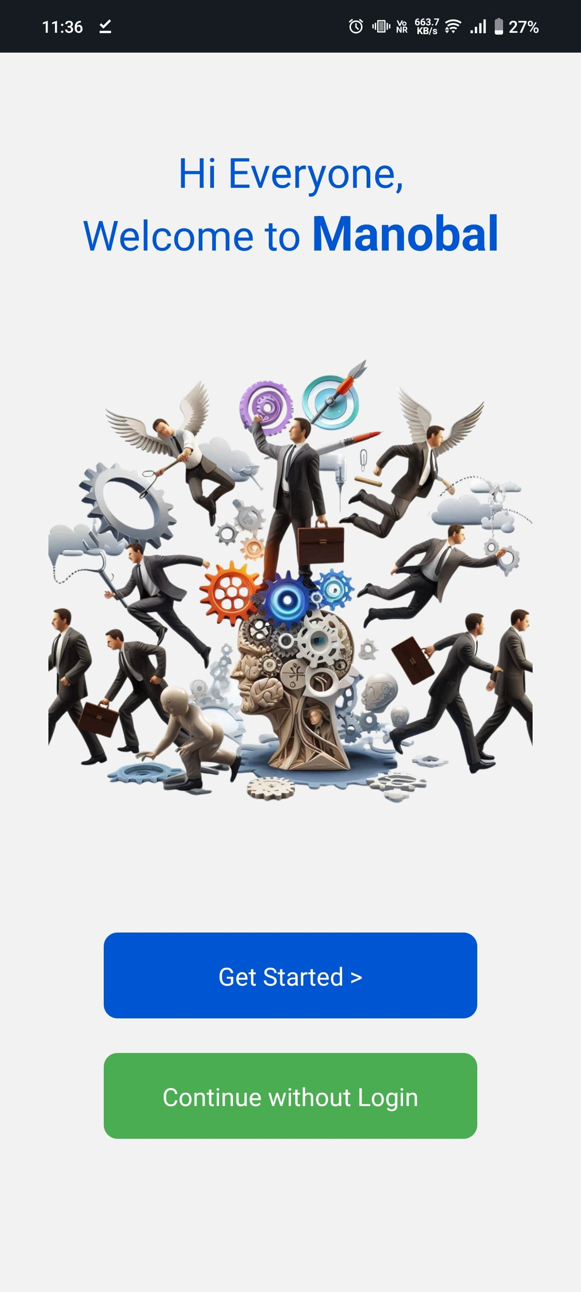
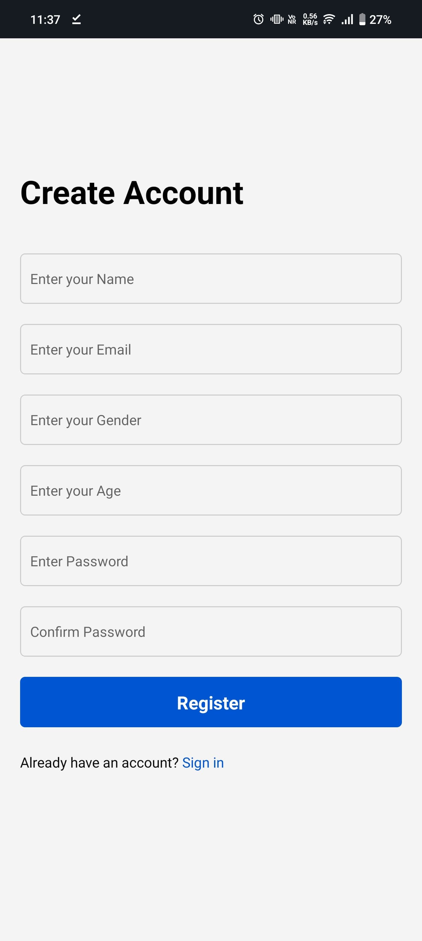
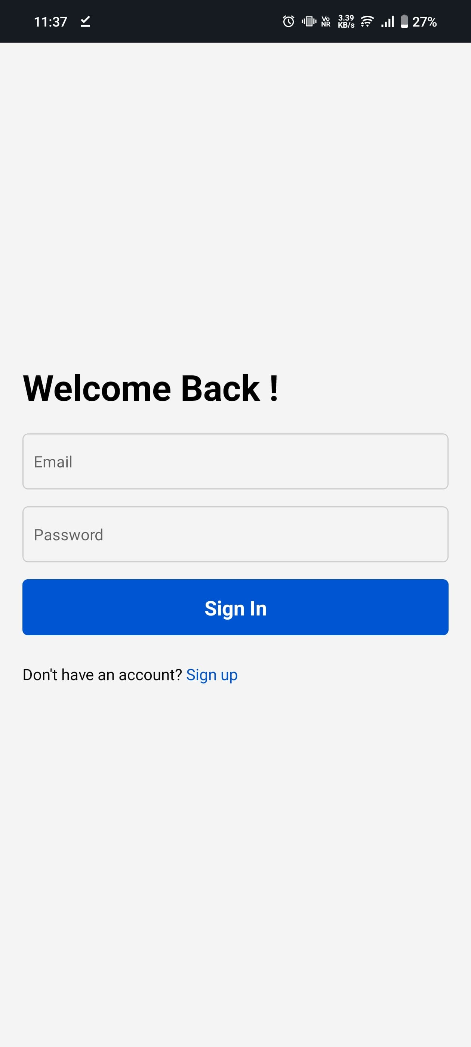
IMPLEMENTATION
Authentication & Authorization Module – Based on JWT Auth
Landing Page | Register Page | Login Page

Slide 7
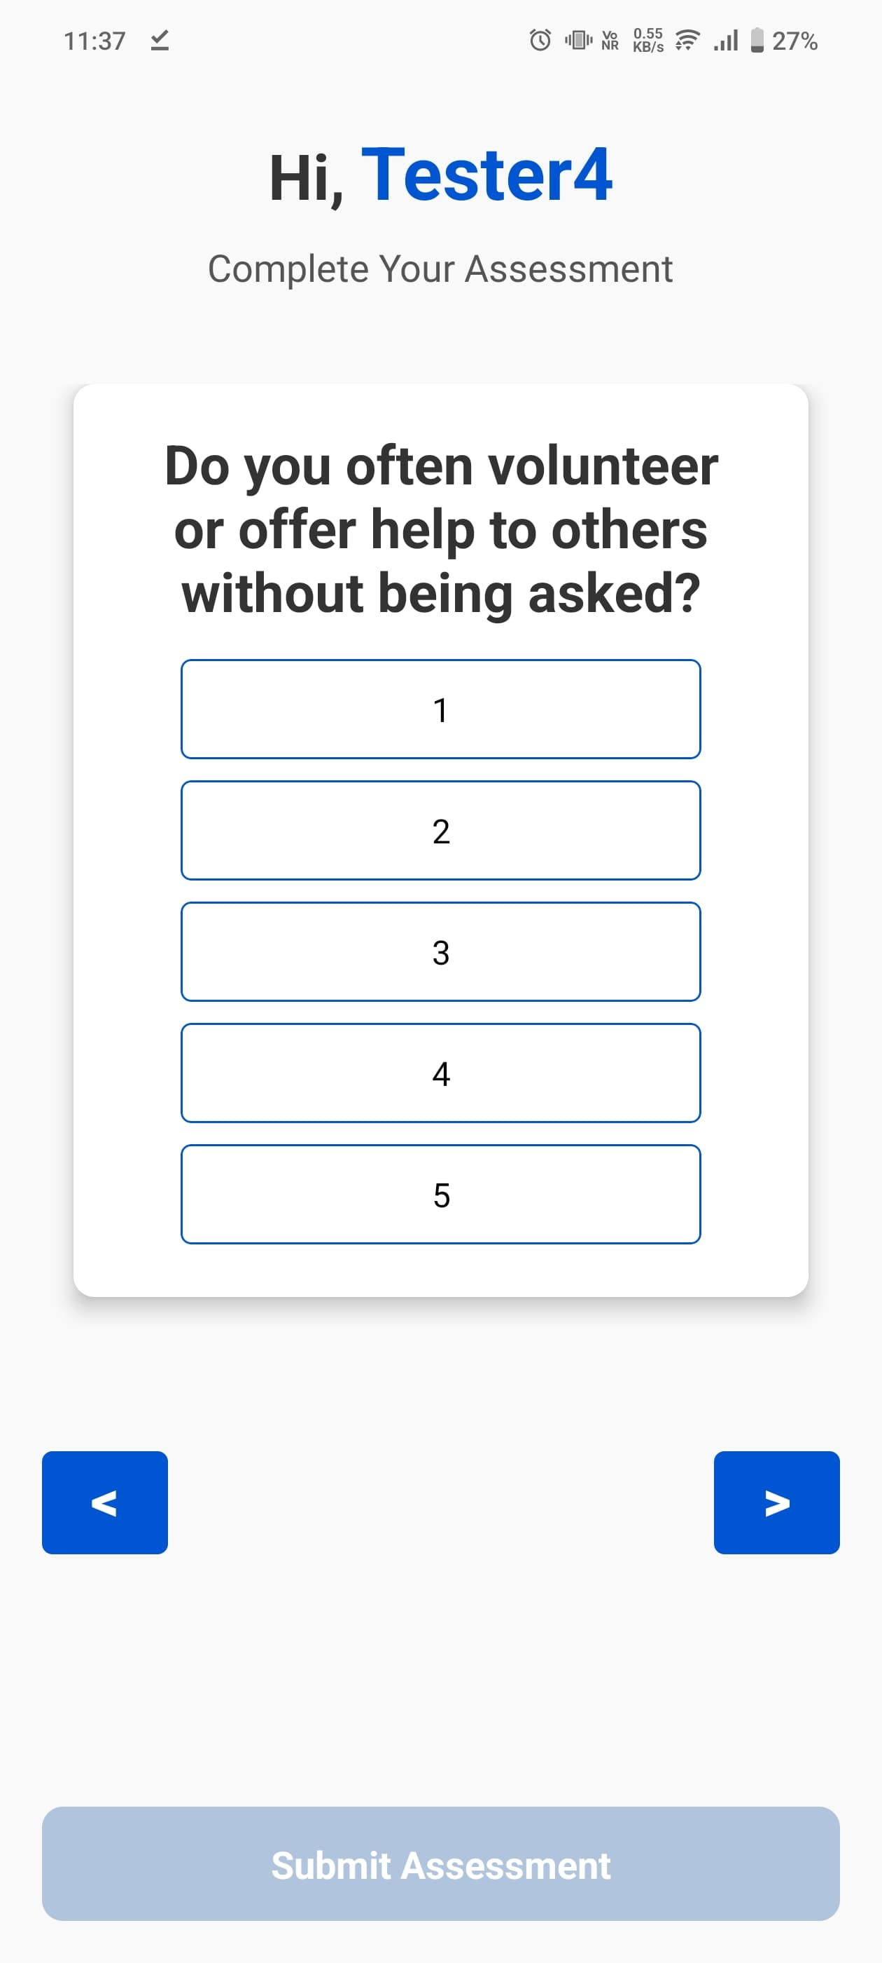
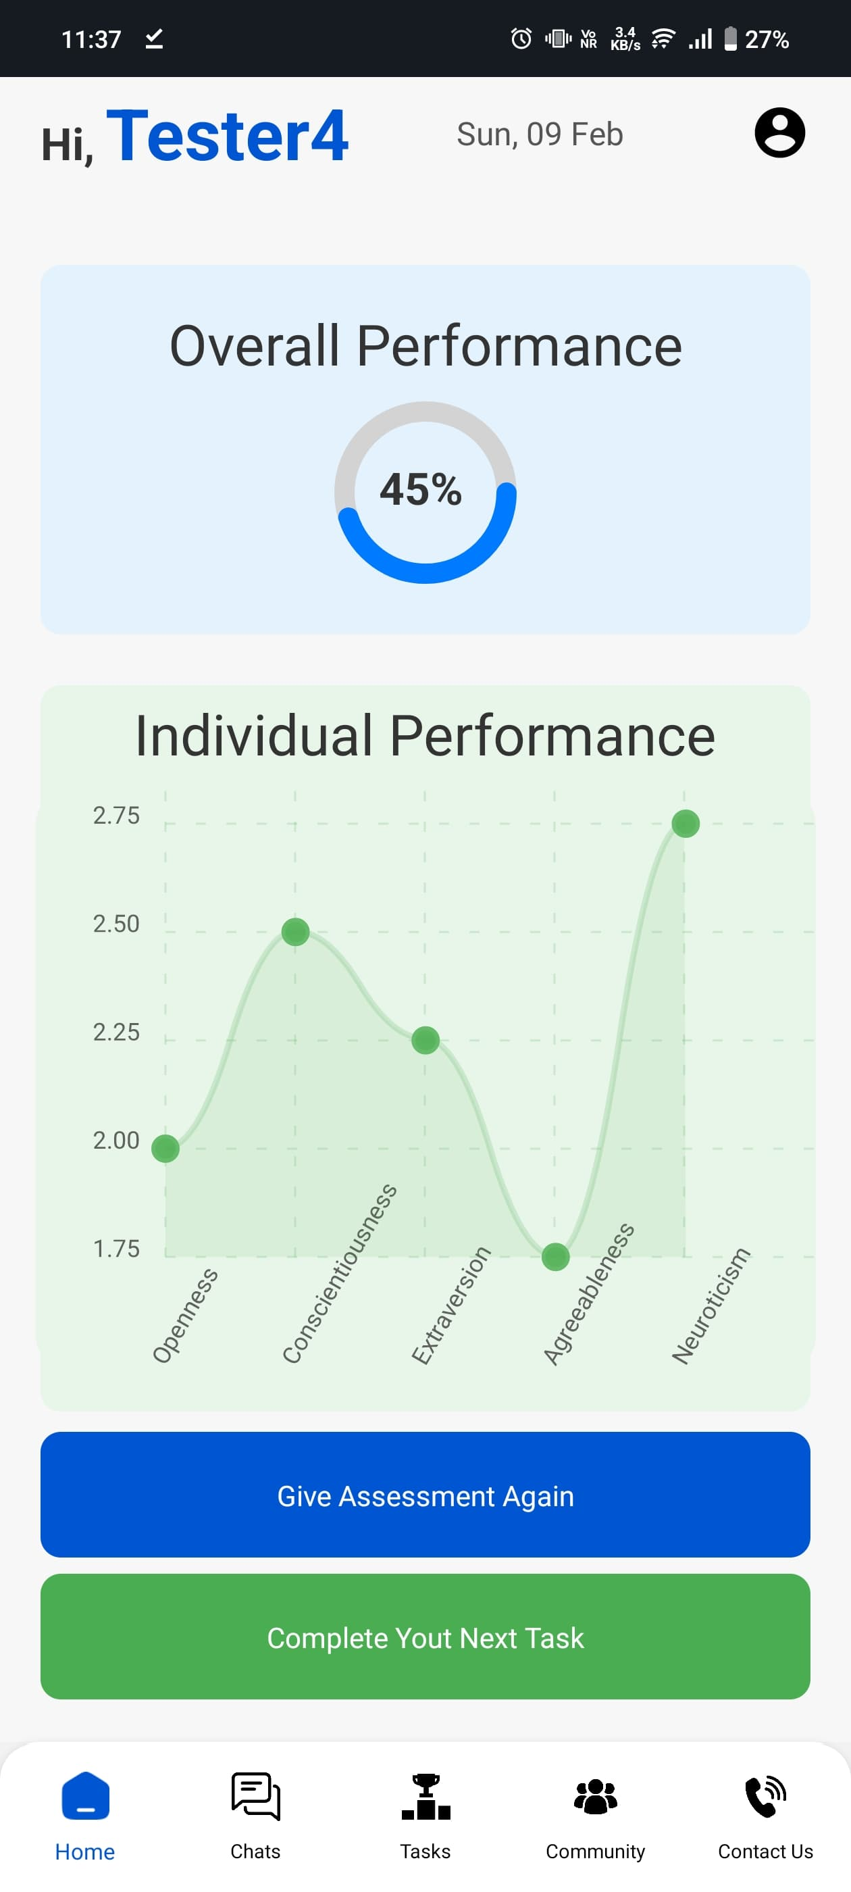
IMPLEMENTATION
Assessment Module – Dynamic Assessment Module ( OCEAN )
Assessment Page | Assessment Result / Dashboard / Home Page

Slide 8
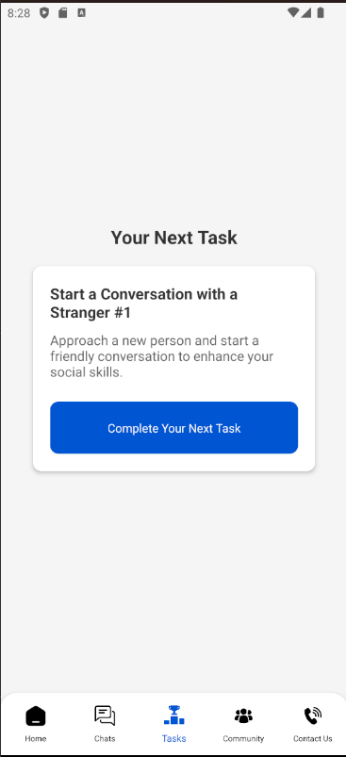
IMPLEMENTATION
Task Generation Module – Generate a New Task & Mark it Complete
| Task Generation Page & Mark Complete Page

Slide 9
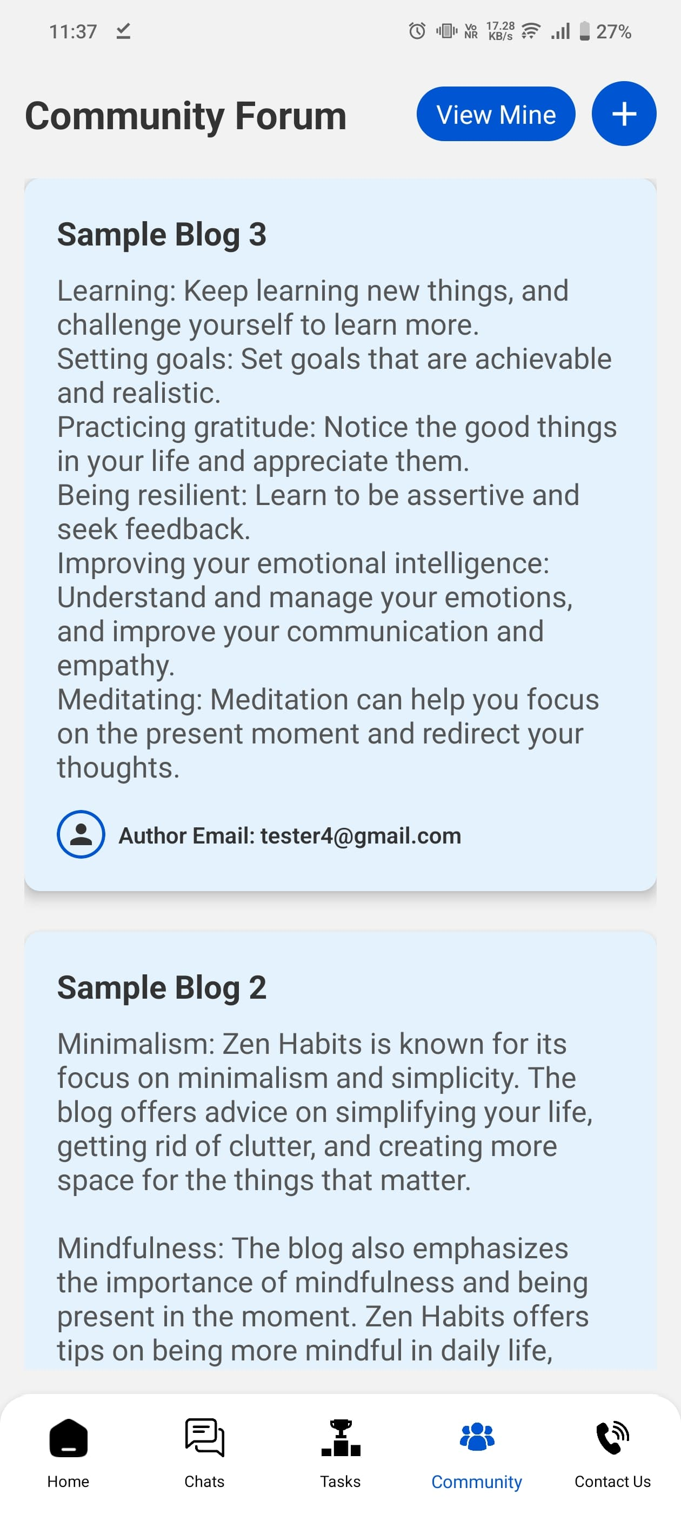
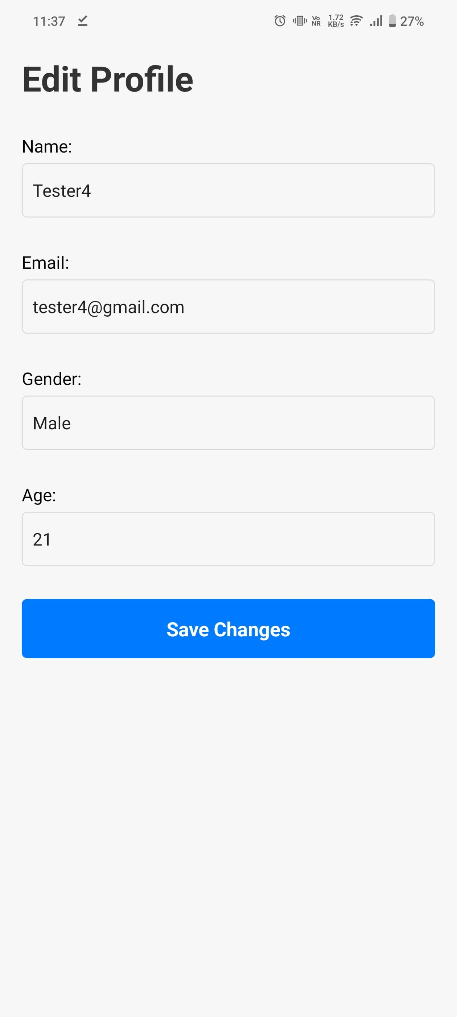
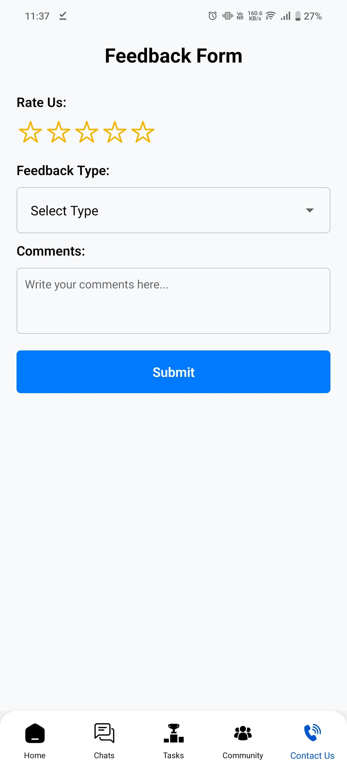
IMPLEMENTATION
Community Module + User Module
Community Page | Edit Profile | Feedback Form

Slide 10
Results
Output of Modules :
User is able to Onboard and Register Himself.
User is able to Login and Give its Assessment by itself.
Our App is able to Assess a user dynamically based on their responses.
A Complete Dashboard for overall and distinct results is there.
User are able to share their POVs over the community Forum via Small Blogs.
User is able to handle their profile & able to Logout.
Intermediate Results :
Successfully able to implement API to generate tasks from DB over thousands of task according to the level of user assessment.
The Feedback Form is complete from UI persective.
Research Paper is under Development. It is completed 60% - 70%.

Slide 11
Conclusions & Future scope
Expansion to Group Discussion : By combining technology with engaging strategies, it provides a unique and comprehensive self-improvement experience.
Voice Recognition for Real-Time Feedback : Integrating voice analysis to assess speech and provide immediate feedback.
Customizable Learning Paths : Users can choose specific areas to focus on based on their career and personal goals.

Slide 12
References
React Native documentation for mobile app development. - https://reactnative.dev/ .
Smith, J., & Doe, A. (2022). AI in Mobile Learning Applications. Journal of Educational Technology, 15(3), 45-67.
Brown, R. (2021). Personal Development and the Role of Adaptive Learning. Self-Improvement Review, 8(2), 113-130.
McCrae, R. R., & Costa, P. T. (1999). A Five-Factor Theory of Personality. Psychological Inquiry, 10(1), 1-43.
John, O. P., Naumann, L. P., & Soto, C. J. (2008). Paradigm Shift to the Big Five Personality Traits: History, Measurement, and Applications. In Handbook of Personality: Theory and Research (3rd ed., pp. 114-158). Guilford Press.
Goldberg, L. R. (1993). The Structure of Phenotypic Personality Traits. American Psychologist, 48(1), 26-34.

Slide 13

Thank you

